Slide 1




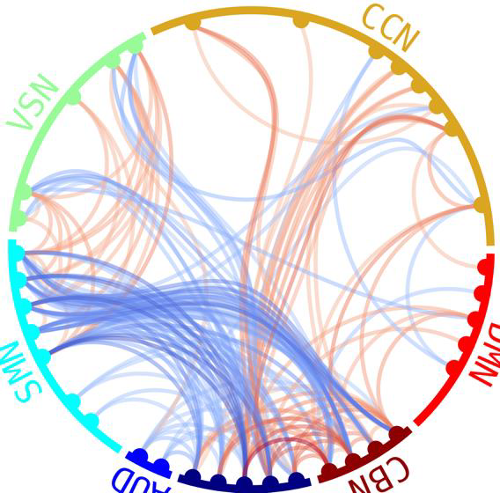
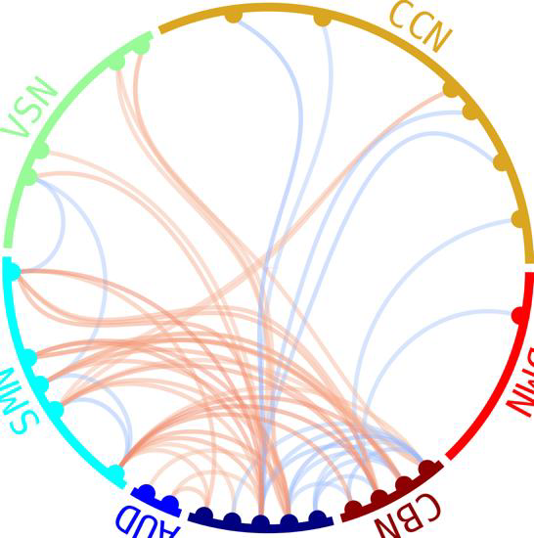
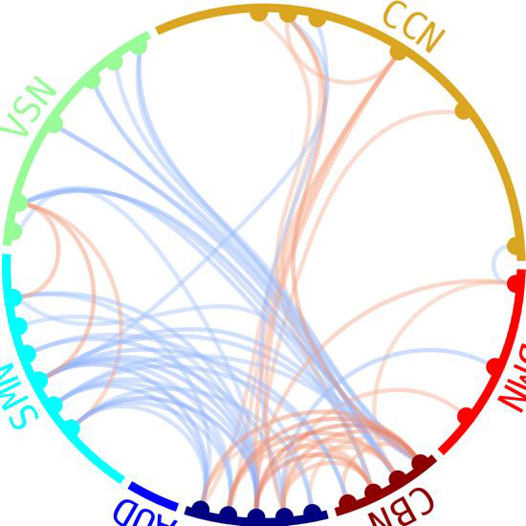
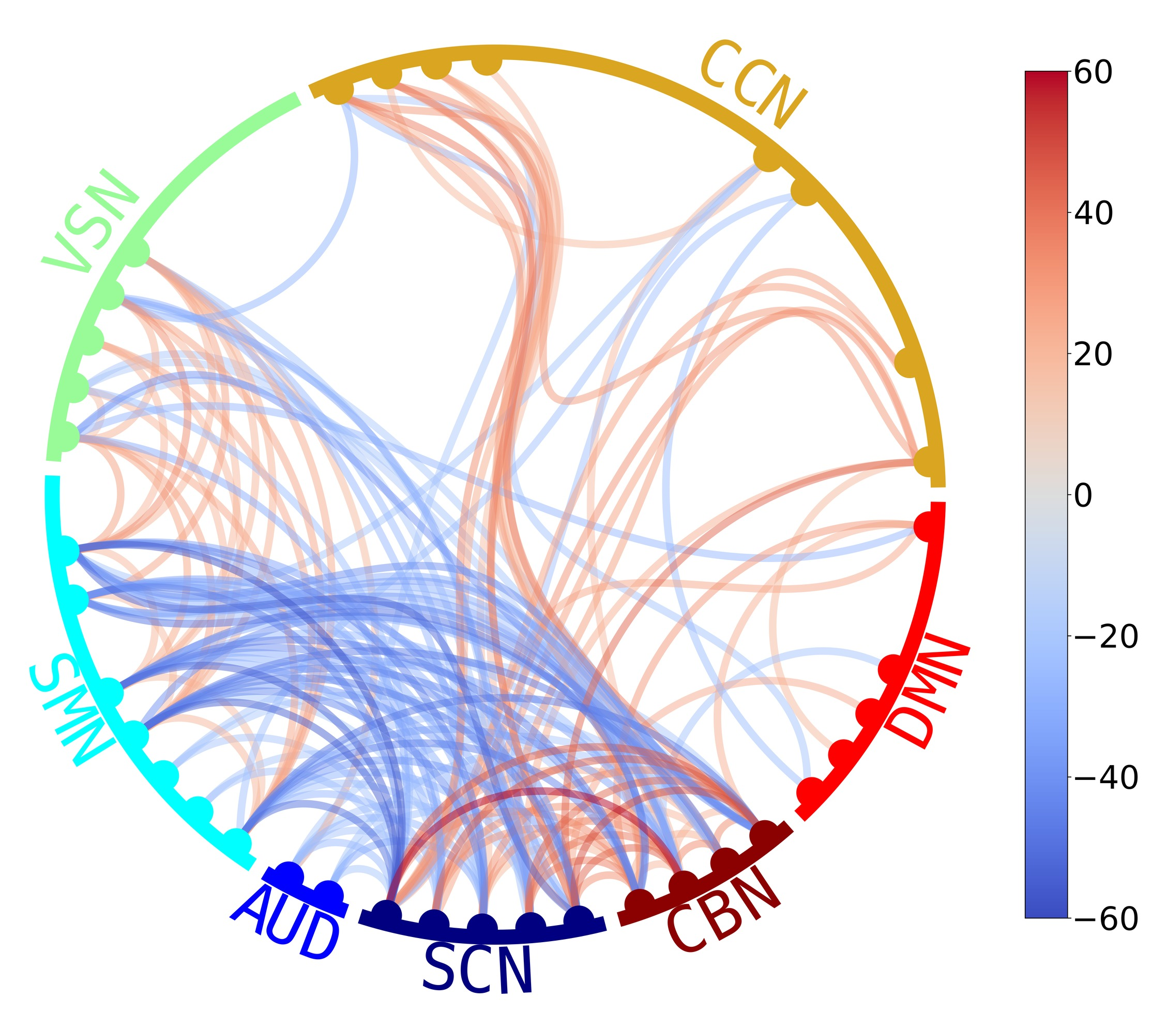
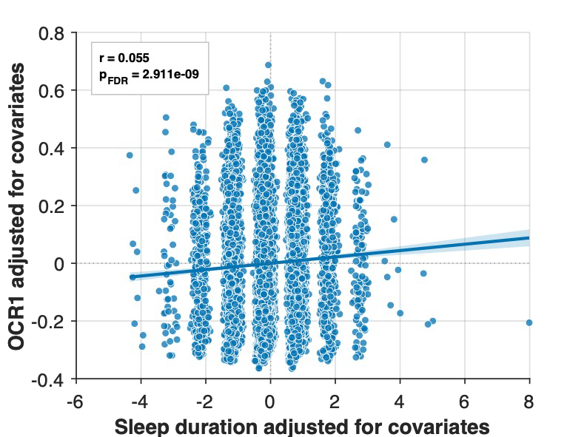
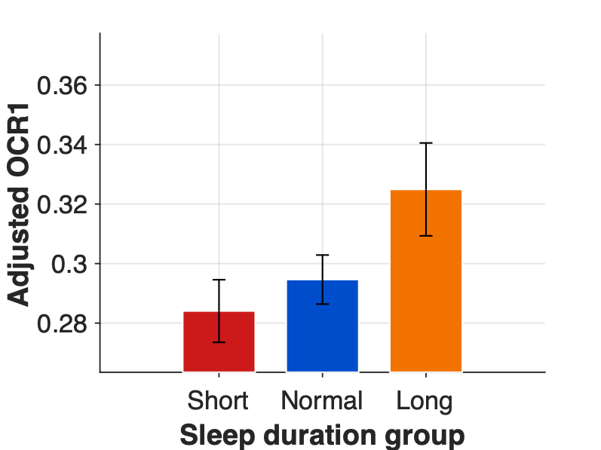
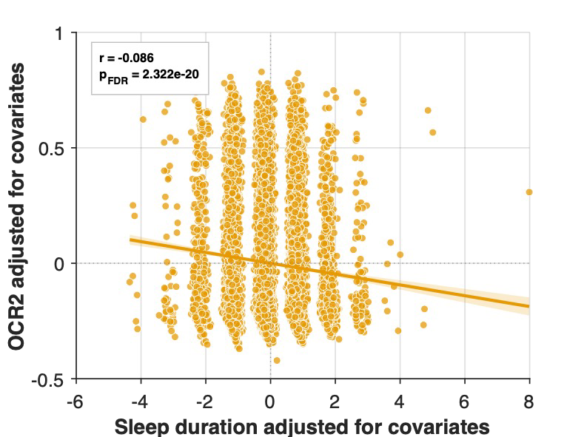
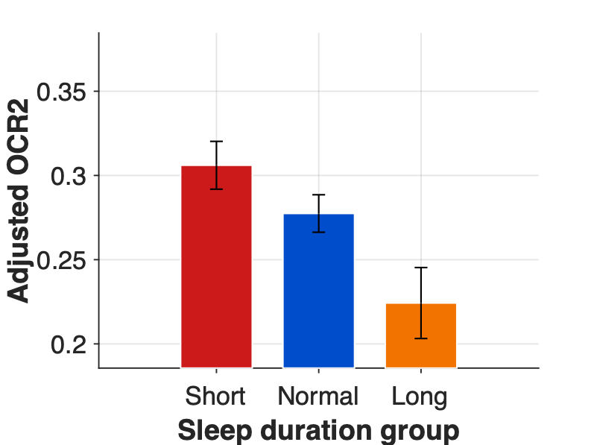
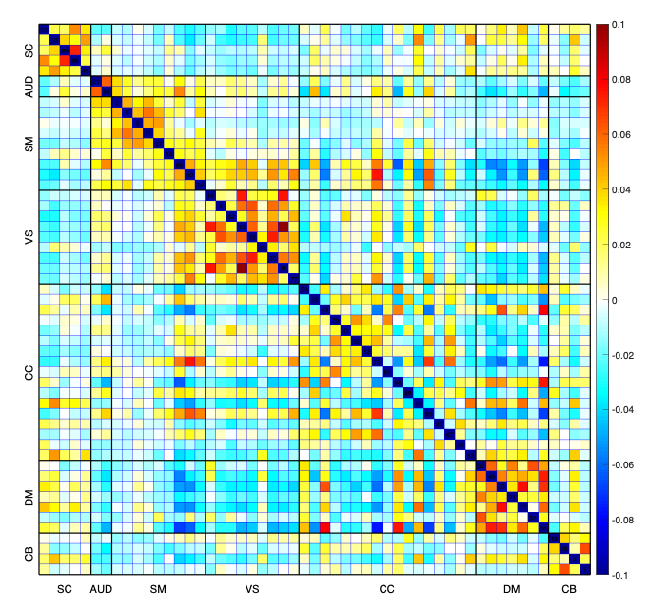
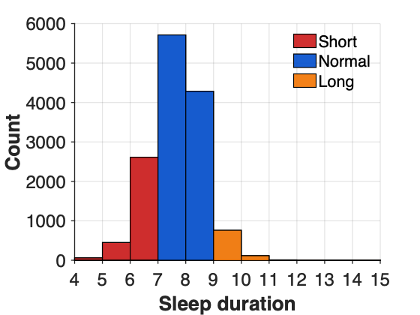
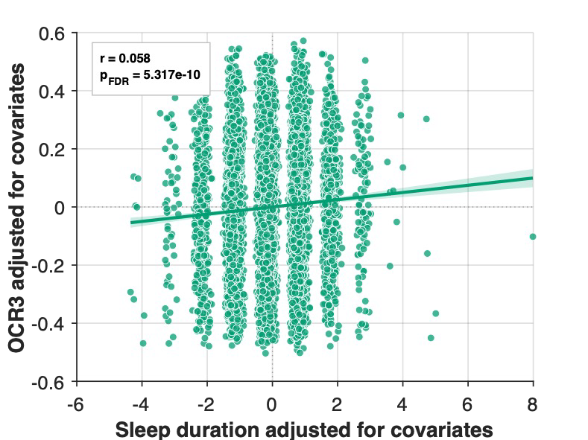
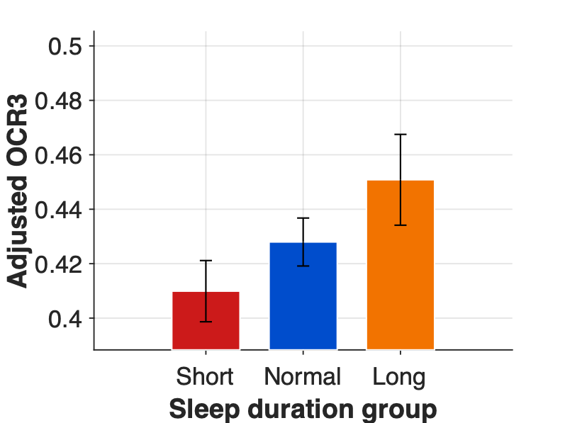
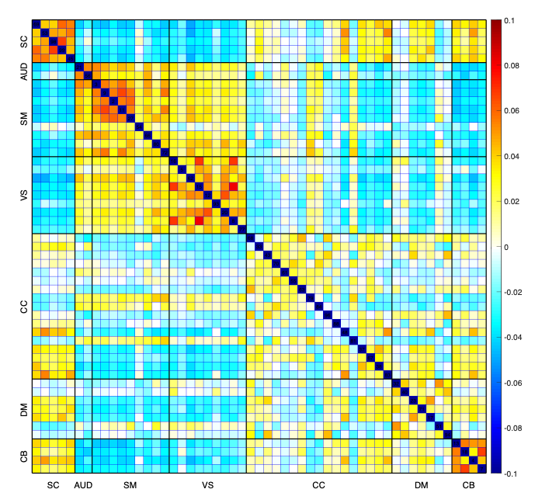
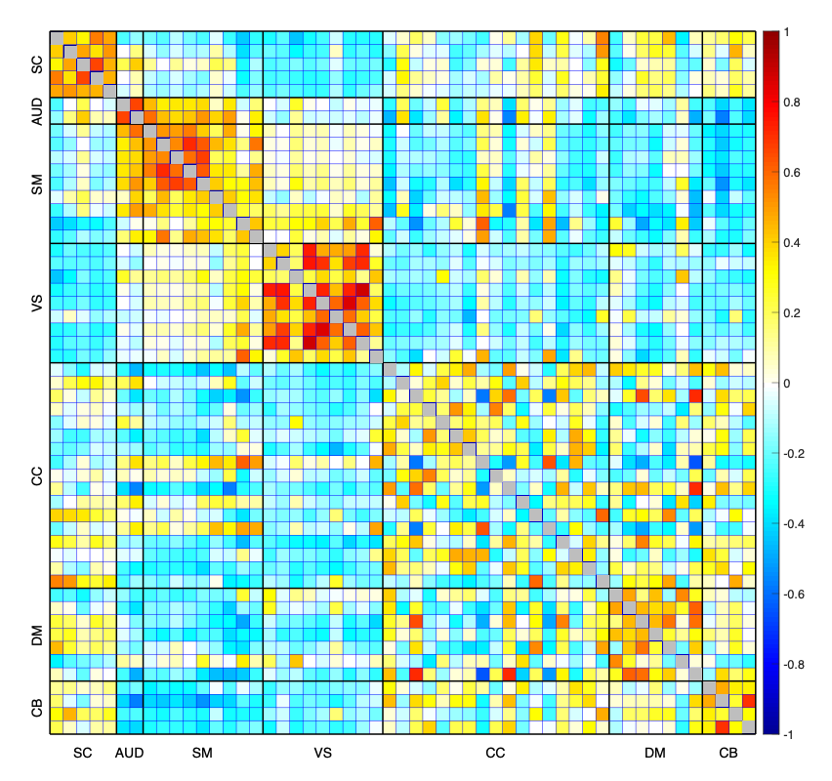
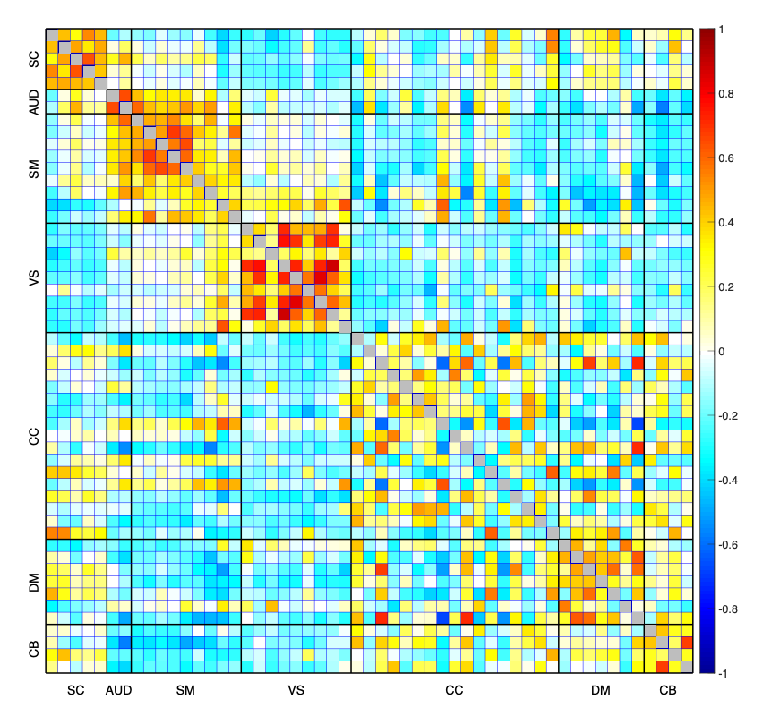
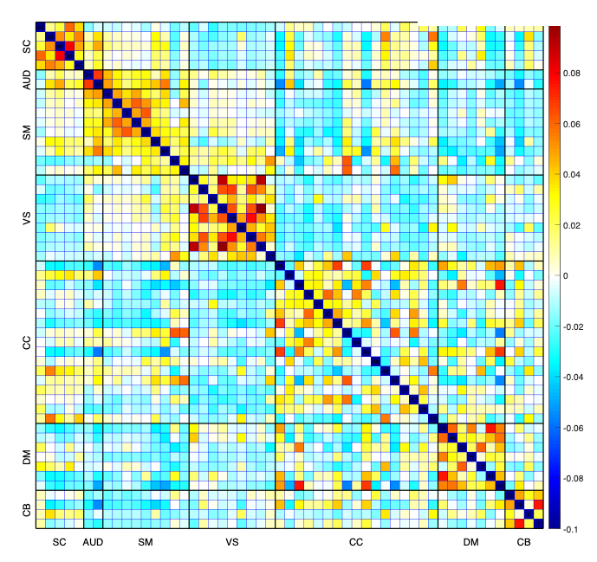
Static and Dynamic Brain Connectivity Patterns Across Sleep Duration
Sabadnoor Singh^{1,2,6} Elaheh Zendehrouh^{3,4} Matthew Gunn^{1,2} Vince D. Calhoun^{3,5} Mohammad S. E. Sendi^{1,2,3}
¹McLean Hospital, Belmont, MA · ²Department of Psychiatry, Harvard Medical School, Boston, MA · ³TReNDS Center, GSU / Georgia Tech / Emory, Atlanta, GA · ⁴School of ECE, Georgia Tech · ⁵Georgia State University · ⁶Department of Psychology, UMass Amherst
INTRODUCTION
RESULTS · STATIC FNC
RESULTS · GROUP CONTRASTS
RESULTS · STATE OCCUPANCY
Sleep duration is closely linked to brain health, cognition, and psychiatric risk. Both short and long sleep are associated with adverse outcomes — cardiovascular disease, cognitive decline, depression, and mortality.
269 of 1,378 connections were significantly associated with sleep duration after Bonferroni correction (p < 0.05/1,378); partial |r| up to 0.151 (r² ≈ 2.28%).
Post hoc pairwise comparisons showed the largest number of significant edges for long versus short sleepers.
Fig. 2B–C — Left: partial-residual plots of occupancy vs. sleep duration (covariate-adjusted; x-axis is residualized, not raw hours). Right: adjusted occupancy by group (mean ± SEM); y-axis ranges vary by state — compare within, not across, panels.
Most imaging work models sleep duration as a single continuous variable — obscuring group-specific effects — and examines only static connectivity, averaging away how networks reconfigure during the scan.
STATE 1 · CONTINUOUS R = 0.055, P_{FDR} = 2.9 × 10⁻⁹
Research question
Do short, normal, and long sleepers show distinct patterns of brain-network organization, or do they simply mirror each other in opposite directions?
Long vs Short
149 edges
Normal vs Short
Normal vs Long
Hypothesis
65 edges
57 edges
Short and long sleep produce non-mirrored differences in both connectivity strength (static) and the temporal expression of recurring brain states (dynamic) — patterns a single continuous sleep-duration term would miss.
Fig. 1D — Pairwise group contrasts surviving Bonferroni correction, same covariate set. Red = first-named group > second; blue = second > first.
Across all contrasts the most consistent differences involved SCN–SMN, CBN–SMN, and CBN–SCN connections, with additional VSN, CCN, and DMN involvement — extending beyond sensorimotor circuitry to sensory and higher-order association networks.
STATE 2 · CONTINUOUS R = −0.086, P_{FDR} = 2.3 × 10⁻²⁰
METHODS · SAMPLE
RESULTS · DYNAMIC STATES
Resting-state fMRI from the UK Biobank . Participants with stress-related, neuropsychiatric, or neurological conditions and those missing imaging or sleep data were excluded.
Fig. 2A — Three recurring connectivity states identified by k-means (k = 3).
14,021
64.2 ± 7.6
6,362 / 7,659
participants
mean age (yrs)
female / male
Fig. 1B — Edges associated with continuous sleep duration after covariate adjustment. Red = positive, blue = negative association.
State 1 — strong within-DMN connectivity, together with within-SMN and within-VSN coupling.
STATE 3 · CONTINUOUS R = 0.058, P_{FDR} = 5.3 × 10⁻¹⁰
Effects were small but widely distributed (partial |r| = 0.035–0.151, mean = 0.064), with dense involvement of subcortical, sensorimotor, visual, cognitive-control, default-mode, and cerebellar components.
The most prominent pattern involved cerebellar connections — CBN–SCN, CBN–SMN, CBN–VSN, CBN–CCN, and CBN–DMN — suggesting distributed rather than focal effects on arousal-related, sensorimotor, and association circuitry.
GROUP-AVERAGE CONNECTIVITY
State 2 — strong within-SMN and within-VSN connectivity with prominent SMN–VSN cross-coupling.
Fig. 1A — Self-reported sleep duration, recorded in whole-hour increments, split into three groups.
ADJUSTED FRACTIONAL OCCUPANCY BY GROUP
Short ≤ 6 h
Normal 7–8 h
Long ≥ 9 h
State
Short ≤ 6 h
Normal 7–8 h
Long ≥ 9 h
n = 3,132
n = 9,997
n = 892
State 1
.284
.294
.324 ↑
METHODS · ANALYSIS
State 2
.306
.278
.224 ↓
Short
Normal
Long
State 3
.410
.428
.450 ↑
1 · NETWORK EXTRACTION
Fig. 1C — Mean 53 × 53 sFNC matrices by sleep-duration group (NeuroMark domains, abbreviated on axes as SC/AUD/SM/VS/CC/DM/CB for SCN/AUD/SMN/VSN/CCN/DMN/CBN). Diagonal (self-connectivity) masked in grey.
State 3 — within-SMN and within-VSN connectivity, with weaker cross-network coupling than State 2.
Covariate-adjusted means; each row sums to ≈ 1 across states within a participant. Graded shift from short → normal → long in every state.
NeuroMark automated ICA → 53 components in 7 domains (SCN, AUD, SMN, VSN, CCN, DMN, CBN) → 1,378 sFNC edges per participant.
2 · DYNAMIC STATES
Group-average matrices share the same large-scale architecture — sleep-duration effects appear as graded shifts in specific cerebellar, subcortical, and sensorimotor edges , not as a reorganization of the connectome.
Pairwise (categorical) tests: long sleepers spent significantly more time in States 1 and 3 and less time in State 2 than both other groups; State 3 occupancy differed across all three pairwise comparisons (p _{FDR} < 0.05).
Sliding window (Hamming, 20 TRs = 14.7 s, step 1 TR; TR = 0.735 s) → k-means clustering. Elbow criterion over k = 2–9 with 100 initializations selected k = 3 . Fractional occupancy (OCR1–OCR3: proportion of windows spent in each state) computed per participant.
3 · STATISTICAL MODELS
CONCLUSIONS — WHY IT MATTERS
LIMITATIONS & NEXT STEPS
sFNC_{i} ~ sleepDuration + C | sFNC_{i} ~ sleepGroup + C
Sleep duration relates to broadly distributed, small-effect differences in both the strength and temporal dynamics of brain connectivity — population-level correlates relevant to understanding sleep and brain health, not yet individual diagnostic markers.
Sleep was self-reported in whole hours (no quality or fragmentation); the design is cross-sectional; group sizes were unequal. The continuous model was linear only, and the three occupancy values sum to 1, so they are not independent outcomes.
OCR_{i} ~ sleepDuration + C | OCR_{i} ~ sleepGroup + C
Effects are distributed, not focal, across the connectome.
Long vs. short gave the broadest thresholded pattern (149 edges) — the largest of any pairwise contrast.
Next: nonlinear (spline) models of sleep duration, compositional analysis of state occupancy, and longitudinal designs with objective (actigraphy/PSG) sleep measures to establish direction and clinical relevance.
C = age, age², sex, site, smoking status, physical activity, alcohol frequency, BMI. sFNC corrected by Bonferroni across 1,378 edges; dFNC by FDR across OCR measures.
Sleep duration also shifts the temporal expression of recurring connectivity states, not just their strength.
Effect sizes are small — occupancy r² ≤ 0.74%, static edges up to r² ≈ 2.28%.
IEEE International Workshop on Machine Learning for Signal Processing · Sep 28 – Oct 1, 2026 · Atlanta, USA
Supported by the Phyllis and Jerome Lyle Rappaport Mental Health Research Scholars Award and the BBRF Young Investigator (Reed Pickus Memorial Investigator) Award. This research was conducted using the UK Biobank Resource.
Contact: msendi@mclean.harvard.edu

